Slide 1
Hybrid made easy.
Modernizing and moving to the cloud with Pivotal Cloud Foundry and AWS.
Ryan Niksch

Slide 2
Hybrid here to stay
Agility
Portability
Unified interface
Guard rails

Slide 3

https://aws.amazon.com/solutions/case-studies/news-liberty-mutual/

Slide 4

Pivotal and AWS better together.
Elasticity
Agility
Availability
$
Faster Time to Market
Infrastructure cost investment
Security

Slide 5
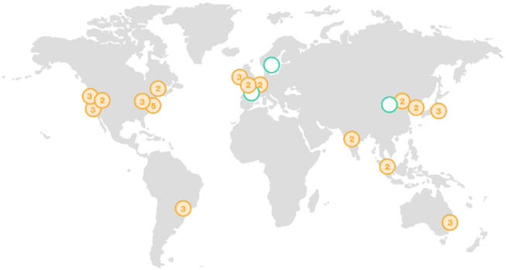
AWS Regions
AZ
Transit
Mesh of Availability Zones (AZ) and Transit Centers
Redundant paths to transit centers
Transit centers connect to:
Private links to other AWS regions
Private links to customers
Internet through peering & paid transit
AZs <2ms apart & usually <1ms
AZ
AZ
AZ
AZ
Transit

Slide 6
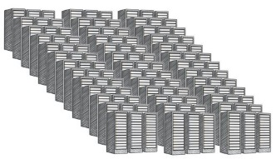
AWS Availability Zones
AZ
Transit
AZ
AZ
AZ
AZ
Transit
Regional cluster of discrete DCs
Separate redundant power, networking, connectivity and facility
All regions have 2 or more AZs
Each AZ is 1 or more DC
No data center is in two AZs
Some AZs have as many as 6 DCs
DCs in AZ less than ¼ ms apart
Data Center
Data Center
Data Center
Data Center

Slide 7
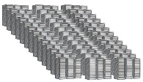
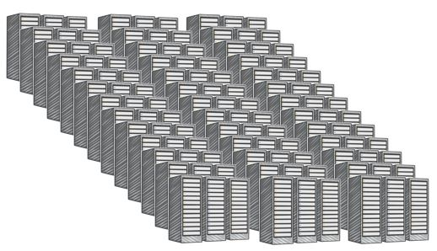
AWS Data Centers
Single DC typically over 50,000 servers & often over 80,000
Larger DCs undesirable to reduce blast radius

Slide 8
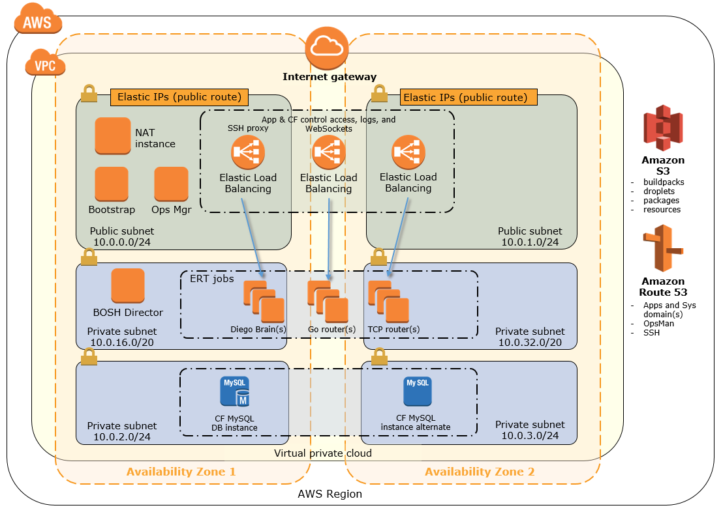
Up and Running now, right now!

Slide 9
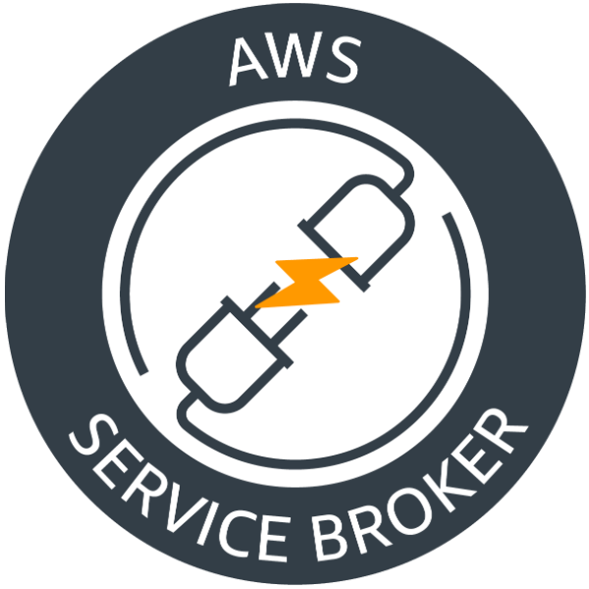














Amazon RDS
Postgres
Amazon RDS
MariaDB
AWS KMS
Amazon
Lex
Amazon S3
Amazon DynamoDB
Amazon EMR
Amazon Kinesis
Amazon SQS
Amazon SNS
Amazon Athena
Amazon Redshift
Amazon RDS
MySql
Amazon Route 53
Amazon
Polly
Amazon Rekognition

Slide 10
Even more agile with Spring Boot.

Slide 11



Standard RIs
These provide the most significant discount (up to 75% off On-Demand) and are best suited for steady-state usage.
Convertible RIs
These provide a discount (up to 54% off On-Demand) and the capability to change the attributes of the RI as long as the exchange results in the creation of Reserved Instances of equal or greater value. Like Standard RIs, Convertible RIs are best suited for steady-state usage.
Scheduled RIs
These are available to launch within the time windows you reserve. This option allows you to match your capacity reservation to a predictable recurring schedule that only requires a fraction of a day, a week, or a month.

Slide 12
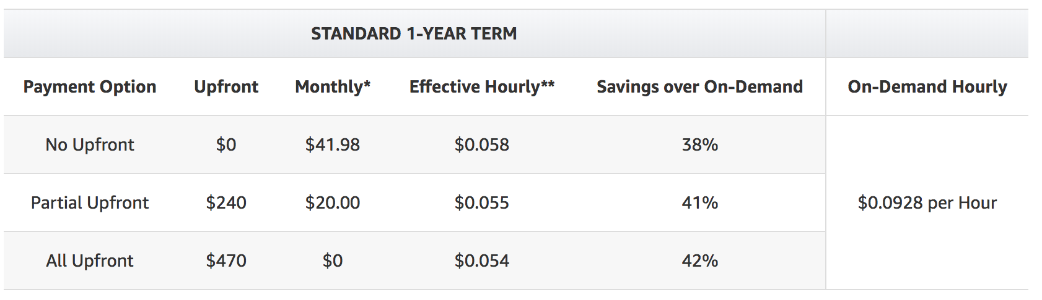
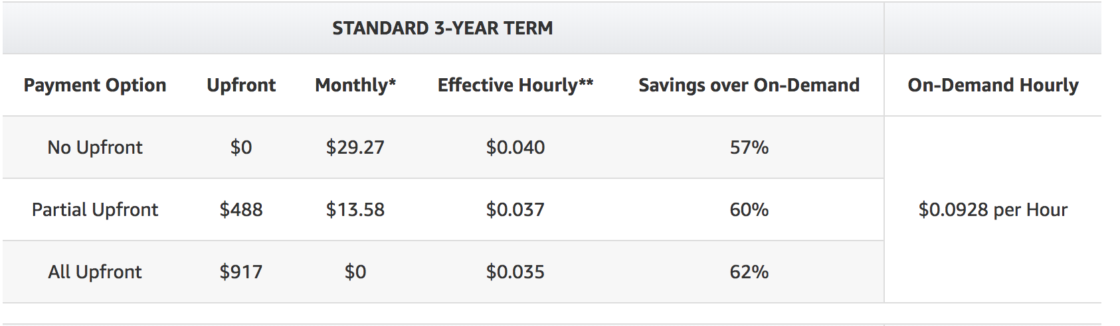
Reserved instances
No Upfront, Partial Upfront, All Upfront

Slide 13
Spot instances
resource_pools:
name: large_ondemand
cloud_properties:
availability_zone: eu-west-1a
instance_type: m2.xlarge
- name: large_spot
cloud_properties:
availability_zone: eu-west-1a
instance_type: m2.xlarge
spot_bid_price: 0.4

Slide 14
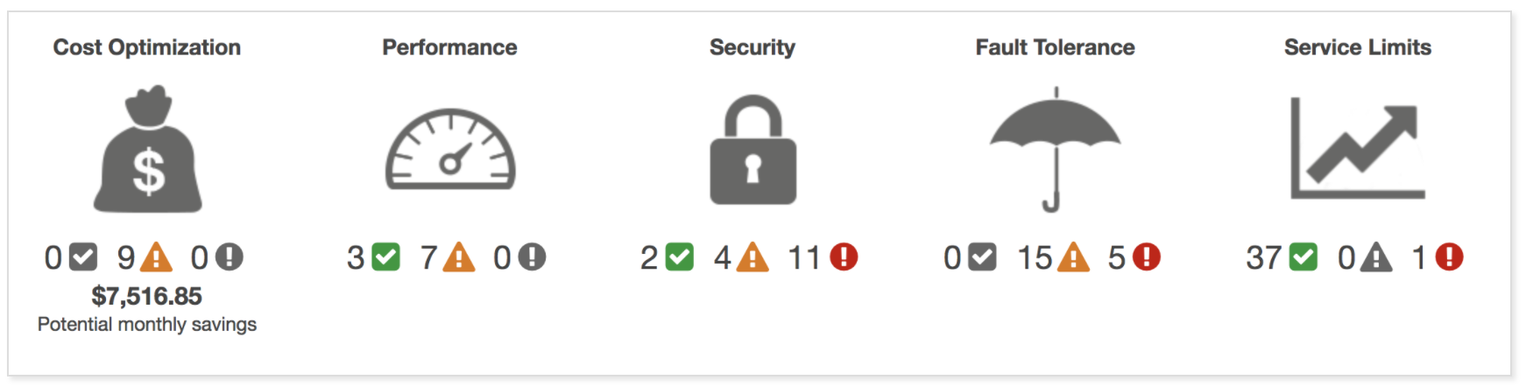
Trusted advisor
AWS Cost Explorer:
Monthly or daily.
Filter
Forecast
Grouping

Slide 15
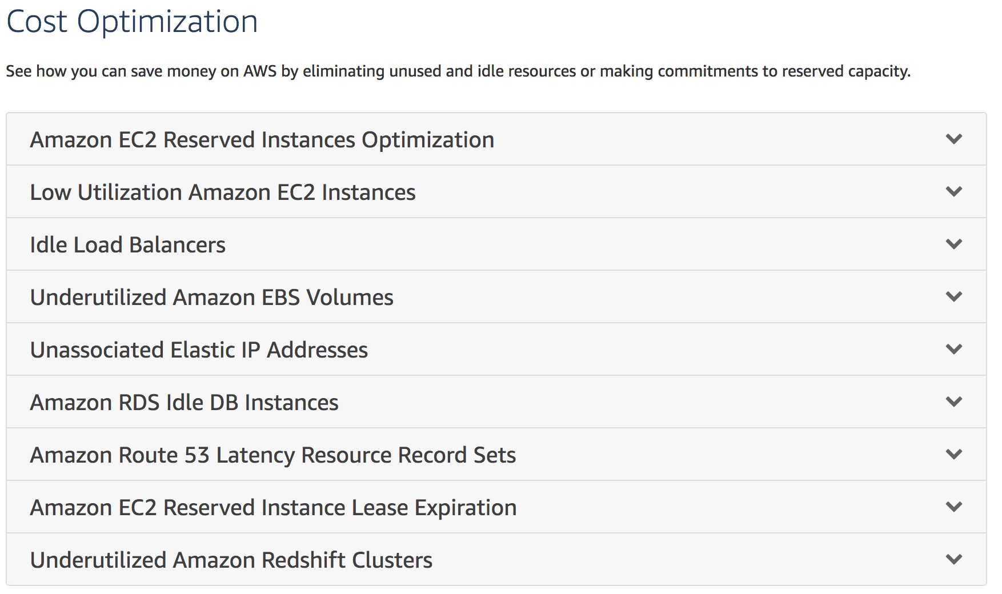

Slide 16
Working together to help you succeed.
POC
PROD

